Slide 1
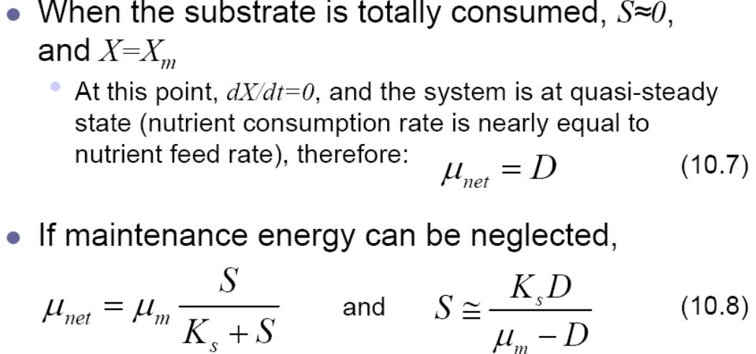
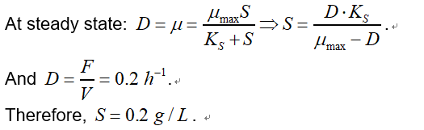
1) Constant feed fed-batch
In a fed-batch culture of Escherichia coli operating with feed of a glucose solution, values of the following parameters are given at time t = 2 h, when the system is at quasi-steady state.
V = 1000 mL dV/dt = 200 mL h⁻¹
s₀ = 100 g glucose L⁻¹ µ_{max} = 0.3 h⁻¹
K_{s} = 0.1 g gluscose L⁻¹ Y_{X/S} = 0.5 g cells (g glucose)⁻¹
X₀ = 30 g (total = x_{o}^{t})
Find V₀ ( the inital volume of the culture)
The feed flow in the fed-batch reactor will be:
dV/dt = F = 200 mL/h
V = V0 + F*t => V0 = V - F*t => V0 = 1000 - 200*2 = 600 ml or 0.6 L
b) Determine the concentration of growth-limiting substrate in the vessel at quasi-steady state at t = 2 h.

Slide 2
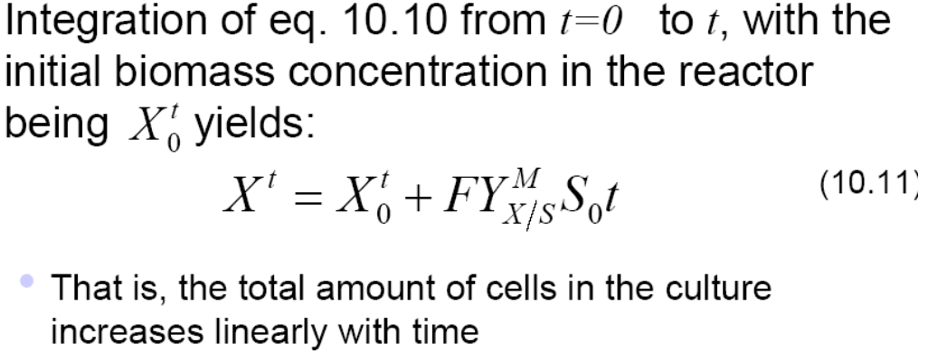
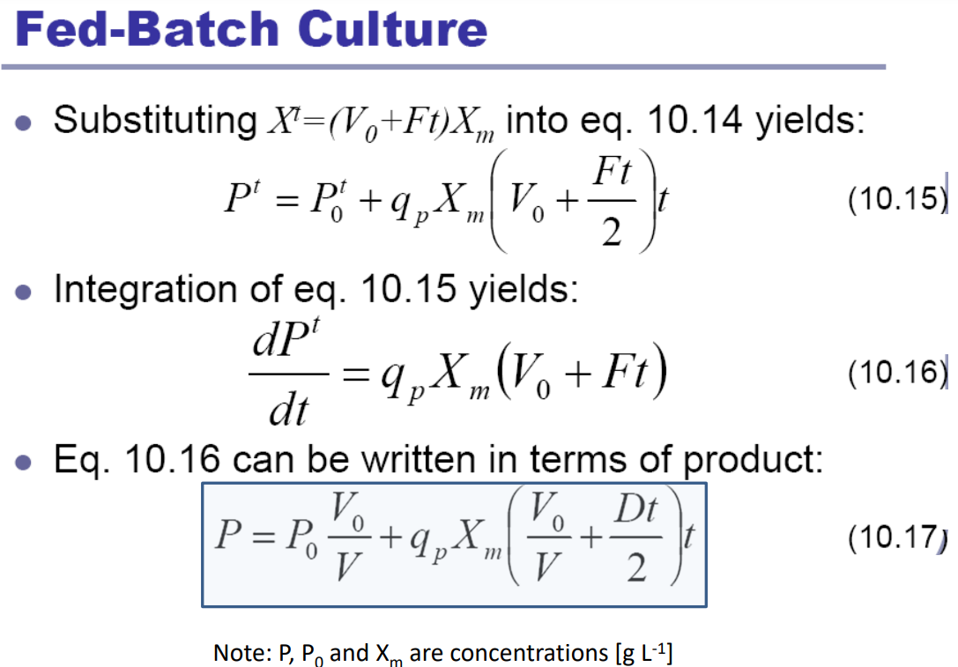
c) Determine the concentration and total amount of biomass in the vessel at t = 2 h (at quasi-steady state)
The concentration at steady state (t = 2h) will be:
or by assuming the volume of the reactor at t = 2h, V = 1 L, then 50 g/L
d) If q_{p} = 0.2 g product (g cells)⁻¹ h⁻¹, p_{O} = 0, determine the concentration of product in the vessel at t = 2 h.
The product will be given by:

Slide 3
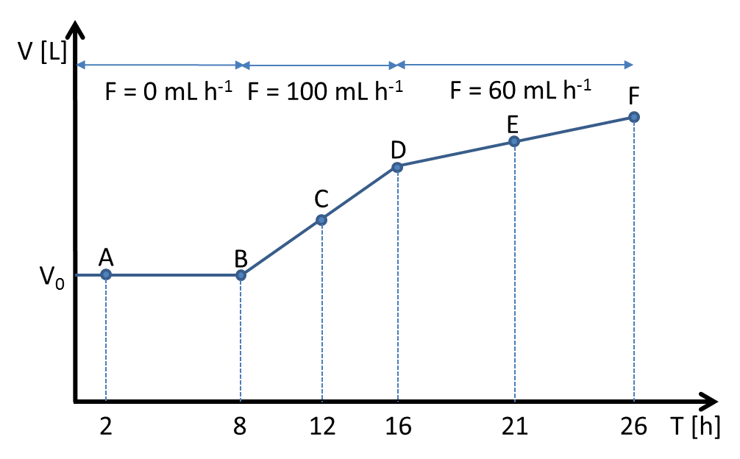
2) Design of a multi-phase fed-batch for the production of lipase
A fed-batch for the production of a lipase is carried out with a recombinant strain Yarrowia lipolytica (see also figure below):
Phase 1: Batch on glucose (s₀ (Glucose) = 6 g L⁻¹)
Phase 2: Fed-batch on glycerol Feed1 s₀ (Glyc) = 1260 g L⁻¹
Phase 3: Fed-batch on lactose with Feed2 s₀ (Lact) = 500 g L⁻¹.
Inoculum batch : X₀ = 0.1 g
a) Calculate the culture volume of the bioreactor at times B, C, D, E, and F
Note: V₀ = A = 2.0 L, V_{B} = V_{A} = 2.0 L
From B to D: feed influx F=0.1 L h⁻¹ and from D to F: feed influx F=0.06 L h⁻¹. V_{t} = V₀ + Ft
B : 2.0 L….. C : 2.4 L….. D : 2.8 L…. E : 3.1 L….. F : 3.4…..
b) Calculate the dilution rates for the time points A, C, and E.
A=0……; C: …0.1/2.4=0.041 h⁻¹ ………………; E: 0.060/3.1 = 0.019 h⁻¹

Slide 4
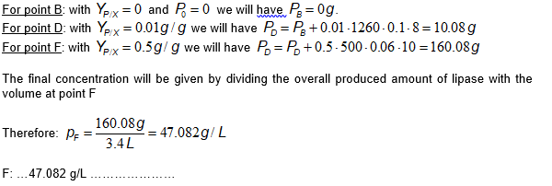
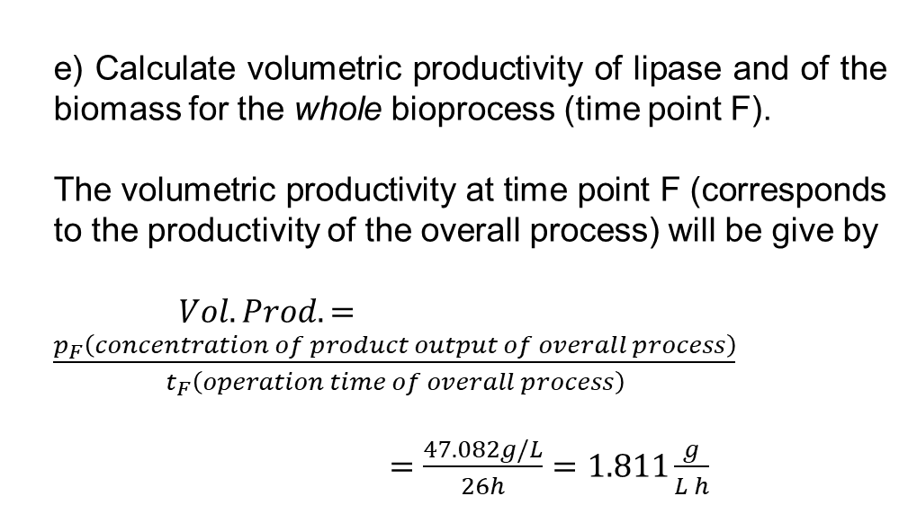
c) Calculate the total biomasses for the time points B, D, and F.
Note: Y_{X/Gluc} = 0.5 g g⁻¹, Y_{X/Glyc} = 0.1 g g⁻¹, Y_{X/Lact} = 0.3 g g⁻¹
B: 6+0.1 g; D: 6.1+0.1*1260*0.1*8=106.9g; F:106.9+0.3*500*0.06*10=196.9 g
d) Calculate the concentration of lipase at the end of the fed-batch (time point F).
Note: Y_{Lipase/X} (Glucose) = 0 g g⁻¹, Y_{Lipase/X} (Glyc) = 0.01 g g⁻¹, Y_{Lipase/X} (Lac) = 0.5 g g⁻¹
To calculate the concentration of the product lipase at the end of each of the three phases (B, D and F) we work in the same manner as in question (c). The formula for calculation of the product is:
e) Calculate volumetric productivity of lipase and of the biomass for the whole bioprocess (time point F).
The volumetric productivity at time point F (corresponds to the productivity of the overall process) will be give by
$Vol.Prod.=\frac{p_{F}\left(concentration of product output of overall process\right)}{t_{F}\left(operation time of overall process\right)}$
$=\frac{47.082g/L}{26h}=1.811\frac{g}{L h}$

Slide 5
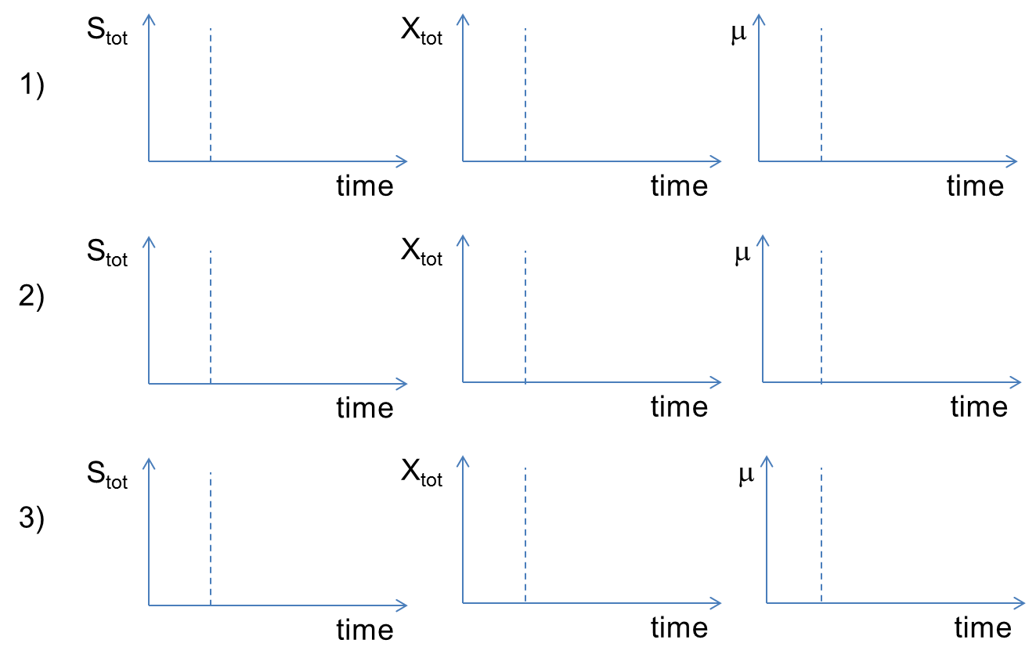
3) Different feed profiles
Please complement the following figures with the trends you are expecting for the respective parameters for the following feed conditions:
Exponential feed; 2) Pulsed feed; 3) Constant feed
Note: Dashed line represents end of batch culture
Maintenance energy

